Slide 1


UNIVERSITY INSTITUTE OF COMPUTING
PROJECT REPORT
ON
Mini DevOps Pipeline using Docker & Shell
Program Name: BCA
Linux Administration
23CAP-305
SUBMITED BY:
Name : Aditya UID : 23BCA10549
Branch : BCA Section/ Group: 9B
Semester : 5TH D.O.SUBMITION : 6 nov 2025
SUBMITED TO:
Name : Rajat kapoor
Desigination: Assistant Professor
sign: ____________________

Slide 2

BONAFIDE CERTIFICATE
Certified that this project report “Mini DevOps Pipeline using Docker & Shell” is the Bonafide work of ”Aditya” under UID “23BCA10549” who carried out the project work under my supervision.
SIGNATURE
UIC DEPARTMENT
ASSISTANT PROFESSOR
RAJAT KAPOOR

Slide 3
Table of Contents:-
Sr. No. | Content Title | Page No.
1. | Title Page | 1
2. | Objective | 2
3. | Aim | 3
4. | Tools / Commands Used | 4
5. | Task / Description | 5
6. | Algorithm / Logic / Flowchart | 6
7. | Code Overview | 7
8. | Output | 8
9. | Conclusion | 9
10. | Learning Outcomes | 10

Slide 4
Objective:
To build a simple CI/CD (Continuous Integration and Continuous Deployment) pipeline using Docker and Shell scripting that automates the build and deployment process of an application.
Aim:
To understand and implement the core concepts of DevOps automation by scripting Docker build and deployment tasks, demonstrating how containerization and shell scripting streamline software delivery.
Tools / Commands Used:
Docker
Bash / Shell Script
Linux Terminal Commands
Dockerfile
Task / Description:
In this project, a simple CI/CD pipeline was created using Docker and Shell scripting.
The pipeline performs the following automated tasks:
Code Checkout / Preparation – Prepares application source code or files.
Docker Image Build – Builds a Docker image from a Dockerfile.
Container Deployment – Runs the image as a container.
Cleanup / Restart – Removes old containers and deploys the latest version automatically.
This approach simulates a basic DevOps workflow, enabling continuous integration and deployment using simple Linux tools.
Algorithm / Logic / Flowchart:
Algorithm Steps:
Start
2. Write a Dockerfile defining the environment and application setup.
3. Write a shell script to:
4. Stop and remove old containers (if running).
5. Build a new Docker image.
5. Run a new container using the latest image.
6. Display the container status.
End

Slide 5
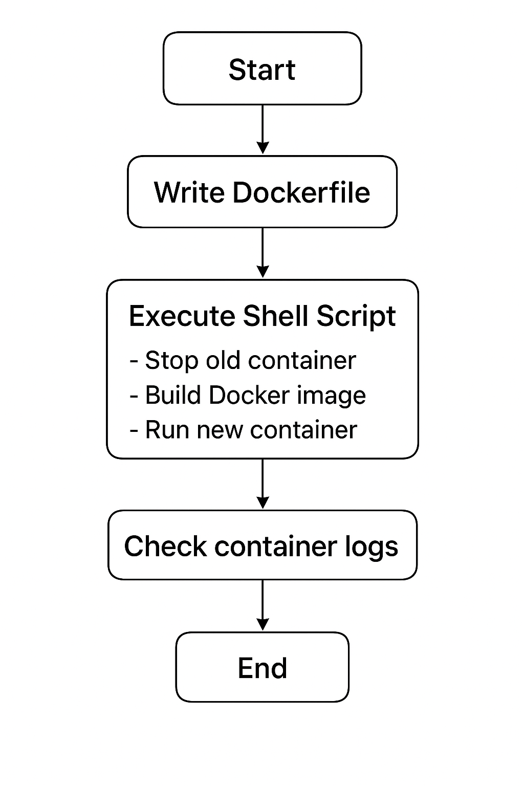
FLOW CHART:

Slide 6
Code Overview:
# Use official base image
FROM ubuntu:latest
# Install dependencies
RUN apt-get update && apt-get install -y nginx
# Copy index file
COPY index.html /var/www/html/
# Expose port
EXPOSE 80
# Start Nginx
CMD ["nginx", "-g", "daemon off;"]
#!/bin/bash
# Stop old container
docker stop myapp 2>/dev/null || true
docker rm myapp 2>/dev/null || true
# Build new image
docker build -t myapp-image .
# Run new container
docker run -d --name myapp -p 8080:80 myapp-image
# Show running containers
docker ps

Slide 7
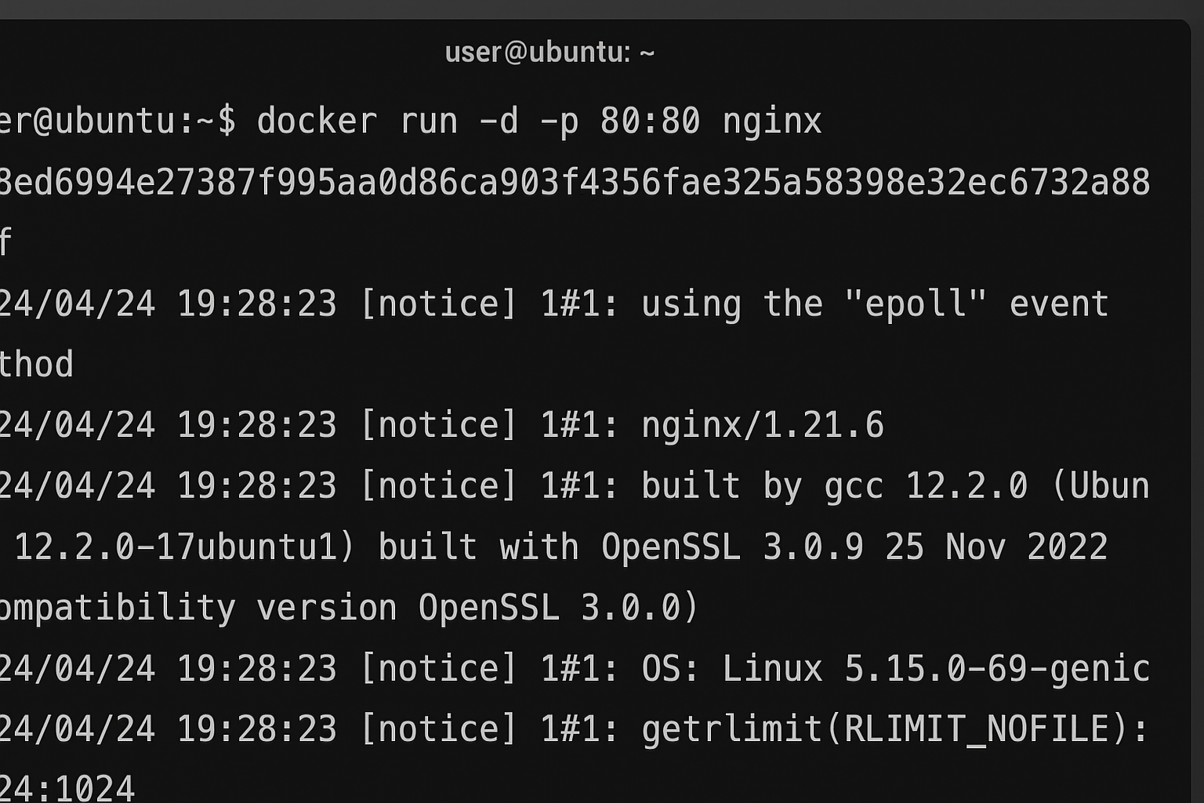
OUTPUT:
After executing the shell script:
The Docker image is built successfully.
The container runs automatically exposing the app at port 8080.
Running docker ps shows the container active and ready.
Sample Output:
$ bash deploy.sh
Successfully built image 'myapp-image'
Container 'myapp' running on port 8080
CONTAINER ID IMAGE STATUS PORTS
abcd1234efgh myapp-image Up 5 seconds 0.0.0.0:8080->80/tcp

Slide 8
Conclusion:
This project demonstrates the automation of build and deployment using Docker and Shell scripting, which are core aspects of DevOps.
It helps understand how CI/CD pipelines automate software delivery, ensuring consistency, speed, and reliability in deployment processes.
LEARNING OUTCOMES:
Understood the concept of DevOps and CI/CD pipelines.
Learned how to create Docker images and run containers.
Gained hands-on experience in automation using Shell scripting.
Improved understanding of Linux-based deployment workflows.

